Slide 1

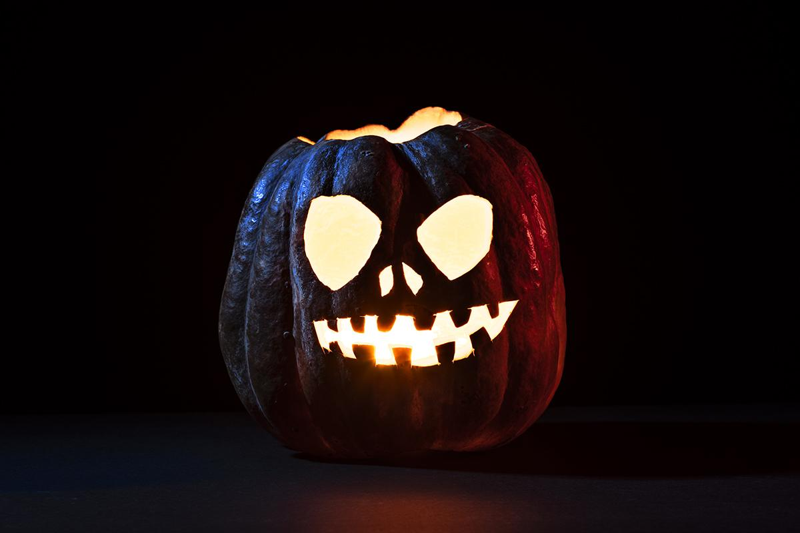

BRAZIL

Slide 2



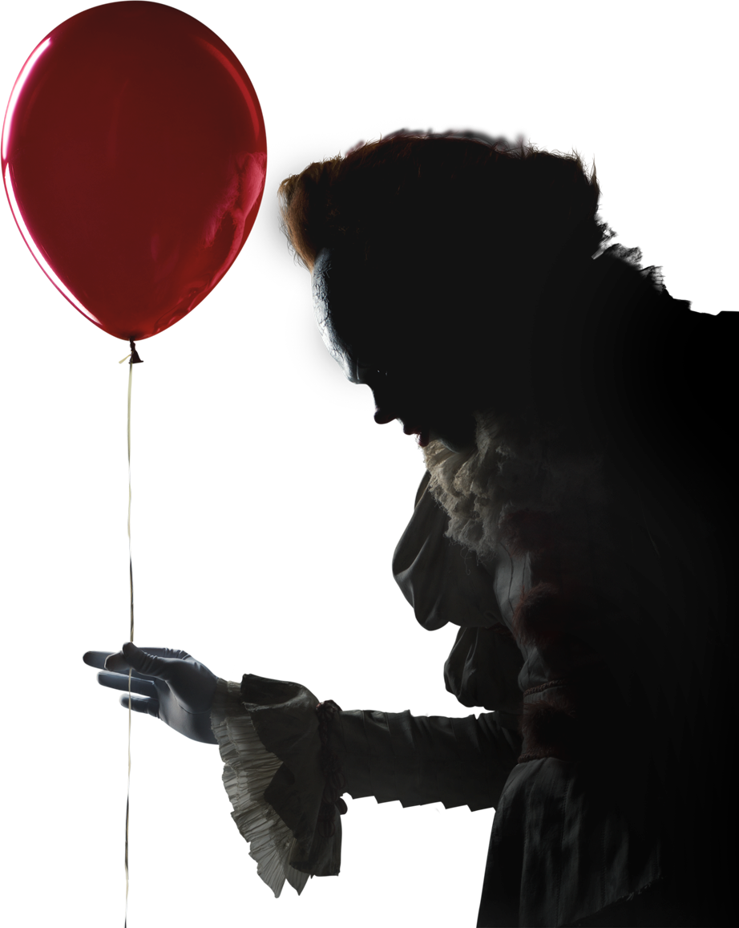
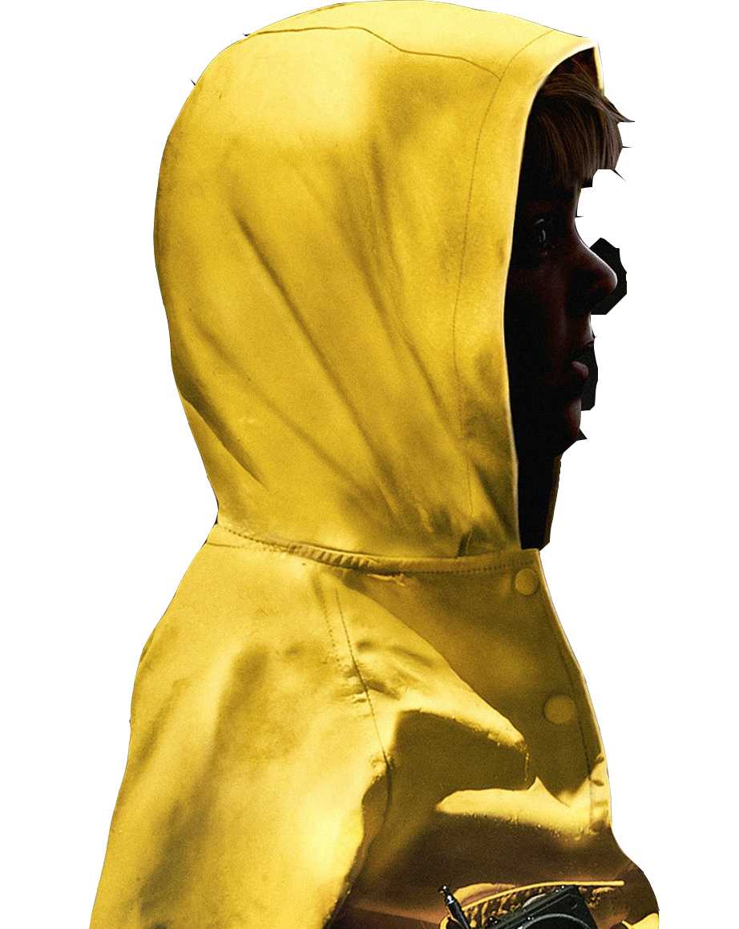
Menu :
Origin
In Brazil
Folklore

Slide 3


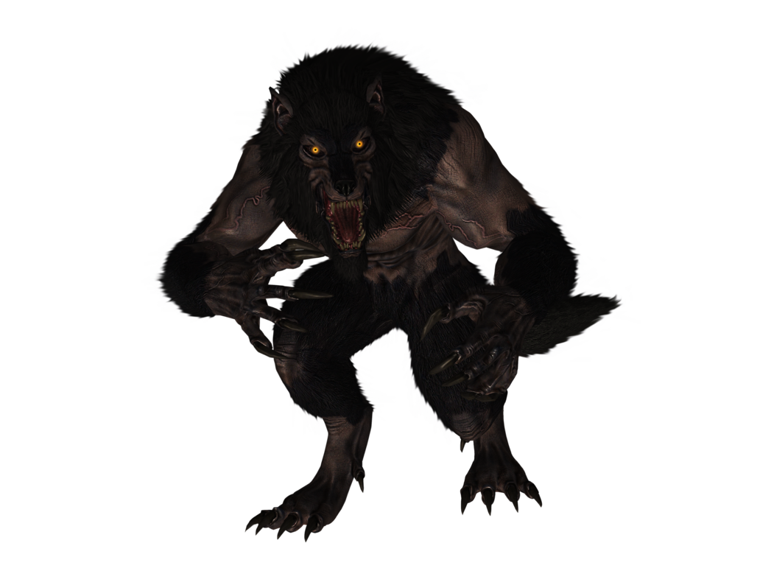
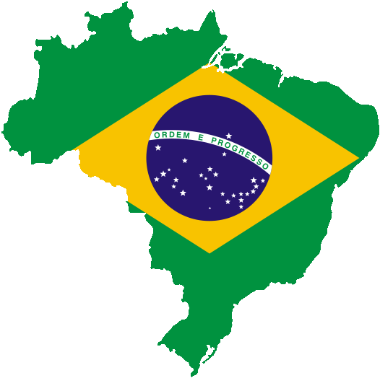


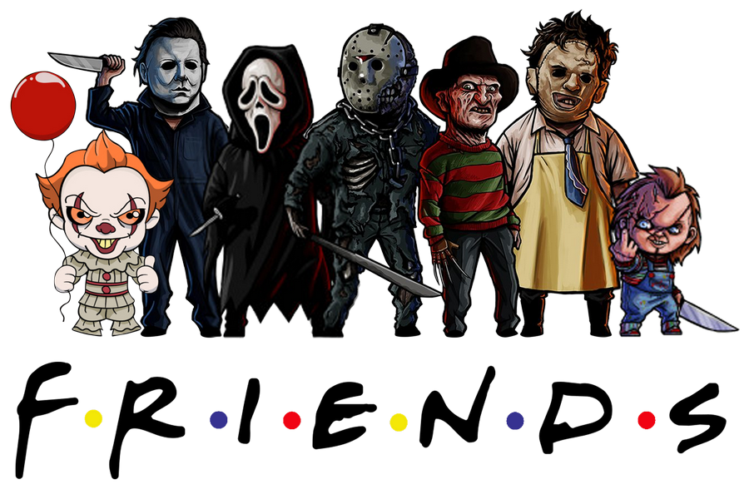
Origin :
31 october
Movies and series

Slide 4
Halloween in Brazil
A little common
Party
Costumes
Business

Slide 5
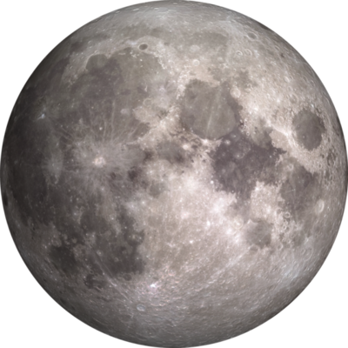
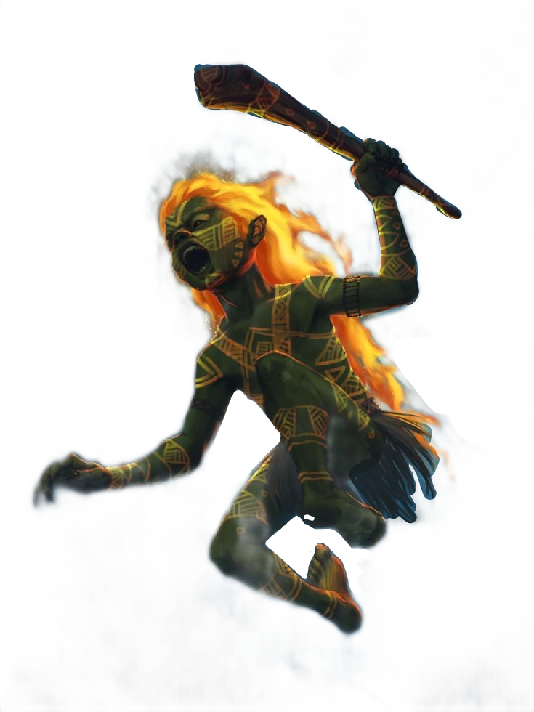
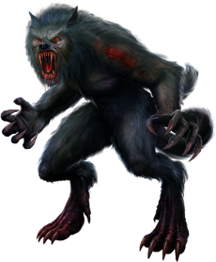
Folklore

Slide 6
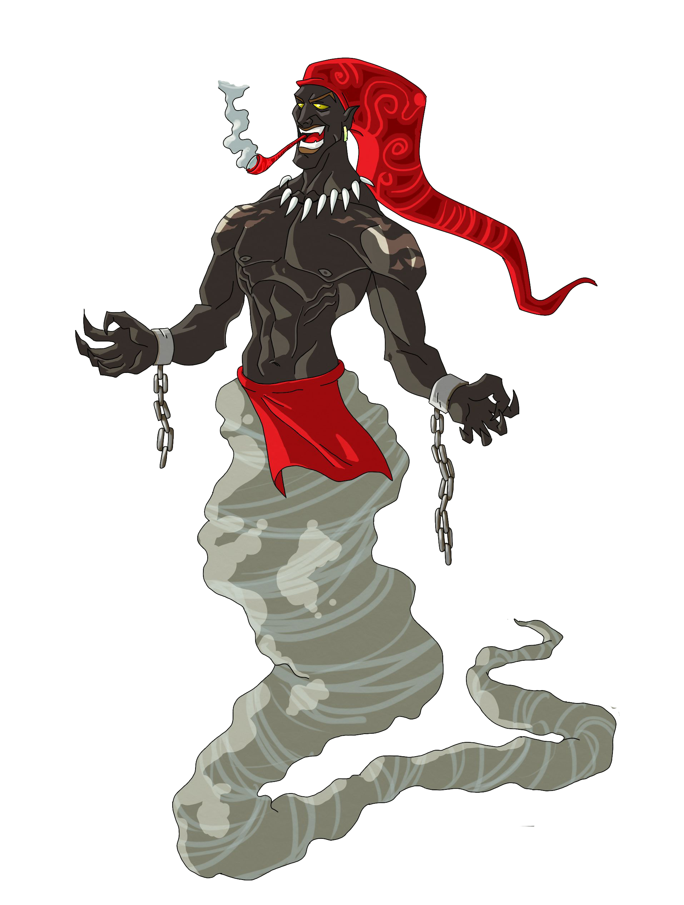
SACI PERÊRÊ

Slide 7
Credits:
Ana Clara
Giovana
Ariany
Maria Isadora
Thifany
Daniel Silva

Slide 8
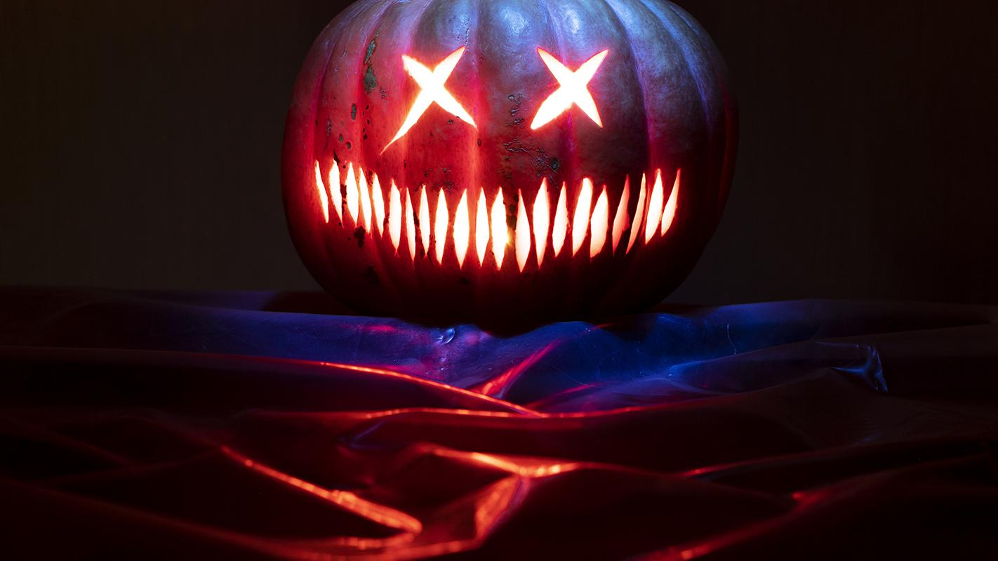
Thank You!

